Slide 1
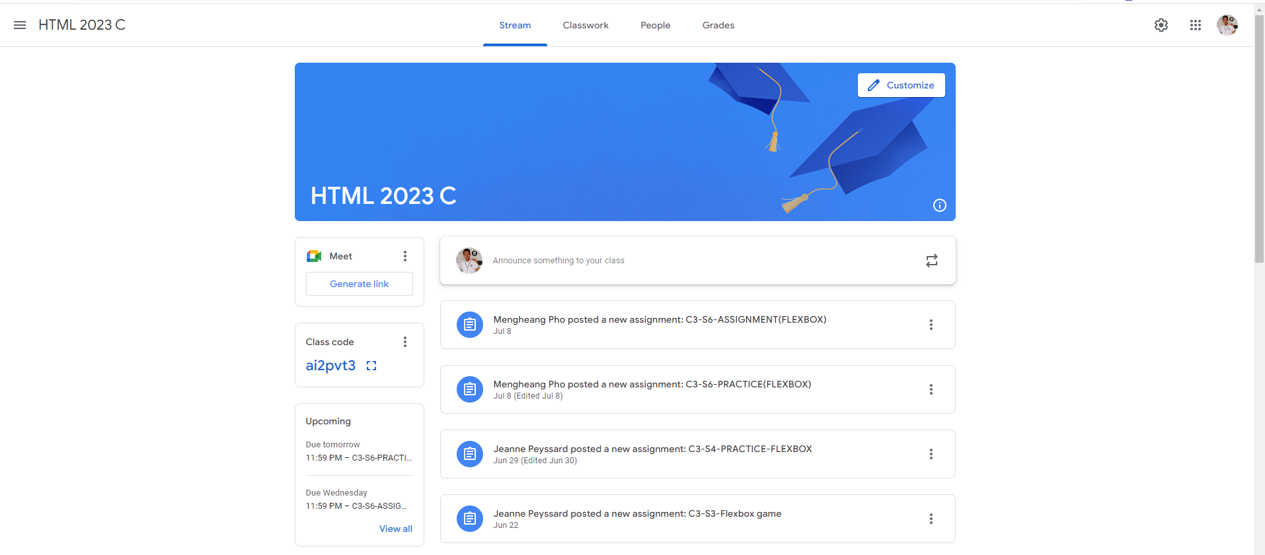
Identify root components of website below

Slide 2
Nav
Header
Display:flex;
flex-direction:column;
container

Slide 3
Menu-bar
Nav-left
Nav-cener
Nav-right
Display: flex;
Justify-content: space-between;

Slide 4
Menu-bar
icon
title
title
title
title
title
icon
icon
icon
Display: flex;
Justify-content: space-between;

Slide 5

Header
div
div
div
Display:flex;

Slide 6
Header
icon
title
Display: flex;
Justify-content: flex-end;
title
icon
Display: flex;
Flex-direction: column;
Justify-content: flex-end;
Display: flex;
Justify-content: flex-end;

Slide 7
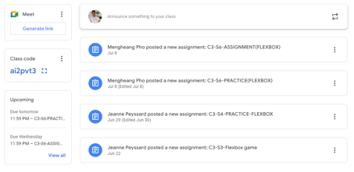
container
Display:flex;
Flex-direction:row;
div
div

Slide 8

container
div
div
Display:flex;
Flex-direction:column;
Justify-content: space-around;
div

Slide 9
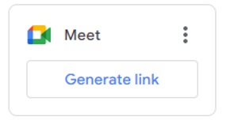
container> asideleft
div
-Display: flex;
-Flex-direction: column;
-Justify-content:space- evenly
div
div
div
Display: flex;
Justify-content:space-evenly
Display: flex;
Justify-content : space-between;
button
icon
title
icon
Display: flex;
Justify-content : flex-end;
title

Slide 10

container> asideleft
Display : flex
Justify-content: space-between;
title
icon
title
icon
div
div
Display : flex
Justify-content: flex-start;
Display : flex
Flex-direction: column;

Slide 11
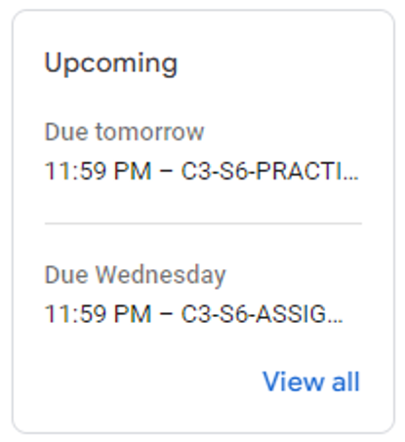
container> asideleft
div
title
div
title
title
div
title
title
div
title
Display : flex;
Flex-direction: column;
Display : flex;
Flex-direction: column;
Justify-content: flex-start;

Slide 12
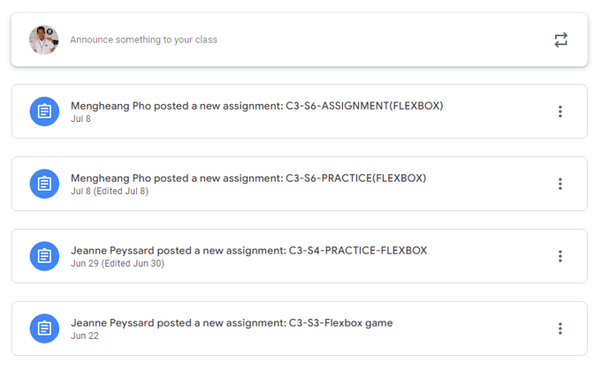
container> content
div
div
div
div
div
Display: flex;
Flex-direction: column;

Slide 13
container> content
div
div
Display: flex;
Justify-content: space-between;
icon
title
icon
Display: flex;
Justify-content: space-between;

